Slide 1
Silicon Valley Chapter American Association of Individual Investors Financial Planning Workshops Investing … Part 1
Website: www.siliconvalleyaaii.org
Email: dstikes.svaaii@gmail.com

Slide 2
Disclaimer
The AAII Silicon Valley Chapter and its directors offer their social media and website pages for educational purposes only.
The opinions expressed here are not necessarily those of AAII or the AAII Silicon Valley Chapter, whose only intent is to provide a background for understanding investment, personal finance and wealth management theory and practice.
Nothing on these sites should be considered solicitations or offers to buy or sell any financial instrument or specific trading advice for individuals.

Slide 3
Silicon Valley Chapter American Association of Individual Investors
Please check us out!
Chapter website: www.siliconvalleyaaii.org
Meetups: www.meetup.com/AAII-Silicon-Valley-Meetup
Facebook: www.facebook.com/sv.aa
YouTube Channel
www.youtube.comchannelUC4GepcU8lzx8rZMaWNBeJtA
AAII National website: www.aaii.com
My email address: dstikes.svaaii@gmail.com

Slide 4
Our Next Event and Special Interest Group Webcasts
Taxes
Saturday November 12th at 9:00am; webcast only
Investing Discussion Group
Lynn Gillette: Fourth Monday of each month at 6:30pm
Computerized-Mechanical Investing Group
Bill Paseman, Don Mauer: First Thursday of each month at 6:30pm
Financial Planning Discussion Group
Debra Stikes: Second Wednesday of each month at 6:30pm

Slide 5
Financial Planning Workshops
We cover a full range of topics in the cycle:
Financial Planning … The Big Picture
Investing I: Modern Portfolio Theory, Building a diversified portfolio
Investing II: Efficient Market Hypothesis; Can you beat the market?
Taxes: TRJA, SECURE Act, Tax diversification, Asset location, QCDs
Retirement Planning I: Tax-advantaged plans, RMDs
Retirement Planning II: Safe withdrawal rates, Bengen’s 4% rule
Risk Management/Insurance: Annuities, Long-term care, Litigation
Social Security and Medicare: Claiming strategies, Medicare traps
Estate Planning: Probate, Executor/trustee duties, Philanthropy
Wrap-up: Case study reviewing previous material

Slide 6
Overview for Today’s Workshop
The 5-step investing process
Asset class characteristics
Modern Portfolio Theory
Building simple multi-asset portfolios

Slide 7
The 5-Step Investing Process
Define your Personal Investor Profile
Document your Investor Policy Statement
Design your personalized portfolio
Implement your portfolio
Review and rebalance periodically

Slide 8
First know thyself !
“If you don’t know who you really are,
the stock market is an expensive place to find out.”
Adam Smith (1722 – 1790)

Slide 9
1. The Personal Investor Profile, PIP
Who am I?
Age, Marital status, Retired, Mortgage etc.
Time horizon?
Short-term goals, long-term goals
Risk tolerance?
Eat well versus sleep well decision
Questionnaires at Schwab, Vanguard, Fidelity, etc.
Income needs?
Need to generate income, capital gains
Tax status?
FIT and SIT brackets, AMT status

Slide 10
Techniques to Control Risk
Diversification of asset classes
Cash / Bonds / Stocks
Domestic / International
Tax diversification
Taxable, tax-deferred and tax-free accounts
Time diversification
Dollar cost averaging
Value averaging

Slide 11
Dollar Cost Averaging
Invest a fixed $ amount at equal periods
Month $Amt SharePr #Shares TotalSh TotalVal
1 $1000 $10 100 100 $1000
2 $1000 $9 111 211 $1899
3 $1000 $8 125 337 $2696
4 $1000 $10 100 437 $4370
5 $1000 $12 83 520 $6240
6 $1000 $11 91 611 $6721
Total $6000 $10.00 611
Average cost of purchased shares = $6000/611 = $9.83

Slide 12
Value Averaging
Adjust balance each period to target value
Month $Amt SharePr #Shares TotalSh TotalVal
1 $1000 $10 100 100 $1000
2 $1100 $9 122 222 $2000
3 $1224 $8 153 375 $3000
4 $250 $10 25 400 $4000
5 $200 $12 17 417 $5000
6 $1413 $11 128 545 $6000
Total $5187 $10.00 545
Average cost of purchased shares = $5187 / 545 = $9.52

Slide 13
Typical Life Cycle Investing
 | Early Career | Mid Career | Late Career | Early Retrmnt | Late Retrmnt
Time Horizon | Long | Long | Long | Long | Medium
Risk Tolerance | High | High | Medium | Low | Low
Income Needs | No | No | No | Yes | Yes
Tax Status | Low | Medium | High | Medium | Low

Slide 14
2. The Investment Policy Statement, IPS
Outlines the general philosophy and objectives for managing the portfolio
Sets the rules and limitations
Defines the asset classes to be used and the broad asset allocation
Decision on asset location
Limits on tactical deviations for market conditions
Documents the rebalancing strategy
Spells out any prohibitions, e.g. no derivatives

Slide 15
Can you Summarize Your IPS on an Index Card?
Example: Christine Benz, Morningstar
Favor equity funds but gradually enlarge bond positions as retirement approaches
Hold cash and municipal-bond funds for near-term expenditures
Check up once a year; rebalance if asset allocation is +/-10% off target allocation
Ten words or less: Fred Smith
Build a diversified portfolio of cheap index funds; Rebalance annually.

Slide 16
3. Design Your Personalized Portfolio
Research the asset classes defined in your IPS
Example: Which specific funds do you prefer to track U.S. stocks? Real estate? Emerging market?
Lowest cost? Least tracking error?, etc.
Asset allocation
Pick an allocation to match your risk tolerance
Asset location
Decide which funds belong in which accounts
Fixed income funds in tax-deferred retirement accounts
Risky hi-growth funds in tax-free Roth accounts
Remaining funds in taxable accounts

Slide 17
Asset Location: Traditional Portfolio Rebalance each account separately
 | Traditional IRA, 401(k), etc. | Regular account | Roth IRA
Fixed Income | 30% | 30% | 30%
Conserv. stocks US stocks | 50% | 50% | 50%
Hi-growth stocks Intl. Stocks | 20% | 20% | 20%
Tax status Distributions | Tax-deferred Gains taxed as Ord.Income | Taxable Gains taxed as Cap.Gain | Tax-free No taxes

Slide 18
Asset Location: Household Portfolio Rebalance total portfolio
 | Traditional IRA, 401(k), etc. | Regular account | Roth IRA
Fixed Income | 30% | - | -
Conserv. Stocks US stocks | - | 50% | -
Hi-growth stocks Intl. stocks | - | - | 20%
Tax status Distributions | Tax-deferred Gains taxed as Ord.Income | Taxable Gains taxed as Cap.Gain | Tax-free No taxes

Slide 19
4. Implement Your Portfolio
Execute the trades to implement the portfolio for each account
Accounts may be at different financial institutions
Traditional IRAs and Roth IRA at Vanguard
Taxable account at Schwab, etc.
Execute all trades …
… immediately
… or Dollar cost average
… or Value average

Slide 20
5. Review and Rebalance
Follow the review strategy defined in your IPS
For a passive portfolio …
… calendar driven
… or threshold driven
For an active portfolio …
… may be necessary to monitor weekly or even daily
… execute trades as spelled out in your IPS
Have you met the return projection and risk level defined in your IPS?

Slide 21
Rebalancing Your Portfolio
Rebalancing is necessary to reduce risk
Most helpful when it is most difficult
Opposite of “Feed the winners and starve the losers”
Periodic or calendar driven: Rebalance annually
Rebalancing more often is not useful
Threshold or data driven: Rebalance as necessary
Check monthly or quarterly, but only rebalance when an actual asset allocation deviates from its strategic value by more than a predetermined amount, say 10% of the strategic value.

Slide 22
Practical Aspects of Rebalancing
Use cash flows into or out of portfolio to rebalance
e.g. monthly contributions, withdrawals, RMDs, etc.
Do not reinvest dividend distributions
Let dividends accumulate in money market account, then use this to make rebalancing purchases
Many retirement plans offer automatic rebalancing

Slide 23
Asset Classes
Fixed income
Cash and cash equivalents
Bonds
Equities
Domestic stocks
International stocks
Alternative investments
Real estate investment trusts (REITs)
Commodities
etc.

Slide 24
The Brinson Study
1986 Study by Gary Brinson et al., Updated 1991
Survey of 82 major pension funds
Contributions to variance in portfolio performance
>91% Investment policy decisions
i.e. deciding on asset classes and weights
<5% Security selection within asset class
i.e. stock picking
<2% Market timing

Slide 25
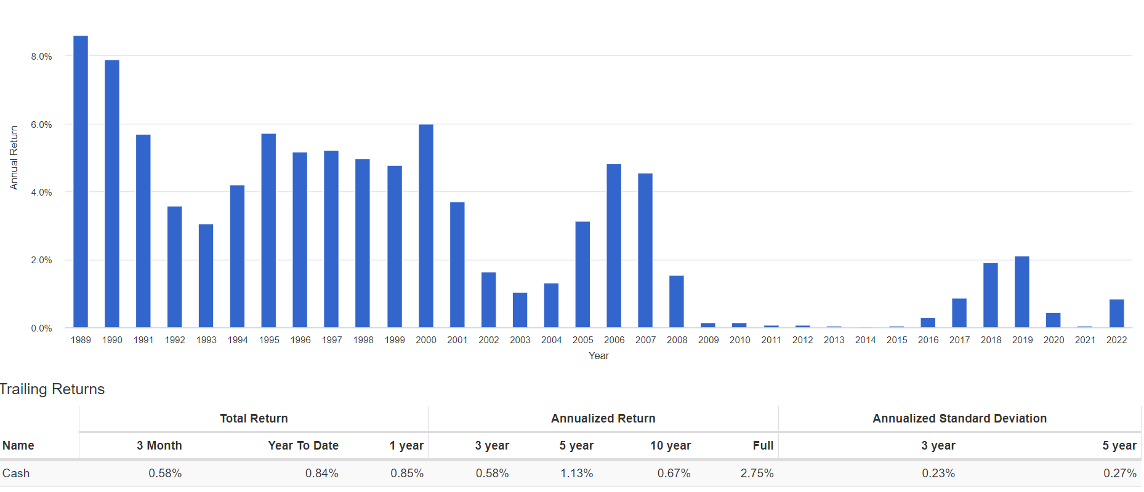
Cash (1989-09/2022) portfoliovisualizer.com

Slide 26
Characteristics for Cash and Cash Equivalents (1989-09/2022)
Low return
Compound Annual Growth Rate = 2.75%
Low risk
Standard deviation = 0.70%
Sharpe ratio = N/A
Best year: 8.61% (1989)
Worst year: 0.03% (2014)
Number of down years: 0/35

Slide 27
Total U.S. Bond Market (1989 - 09/2022) portfoliovisualizer.com

Slide 28
Characteristics for Total US Bond Market (1989-09/2022)
Higher return than cash
Compound Annual Growth Rate = 5.14%
Higher risk
Standard deviation = 3.92%
Sharpe ratio = 0.62
Best year: 18.18% (1995)
Worst year: -14.65% (2022)
Number of down years: 5/35

Slide 29
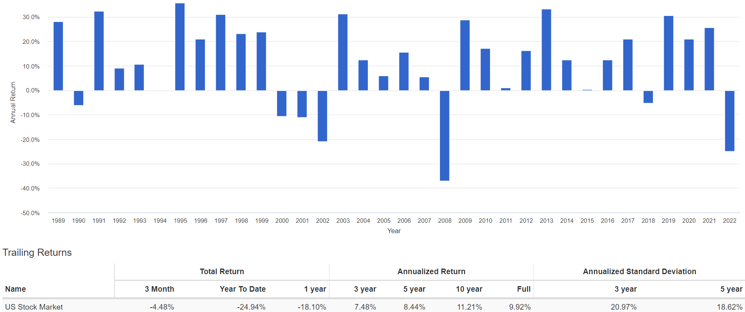
Total U.S. Stock Market (1989 – 09/2022) portfoliovisualizer.com

Slide 30
Characteristics for Total US Stock Market (1987-09/2021)
Higher return than cash or bonds
Compound Annual Growth Rate = 9.92%
Significantly higher risk
Standard deviation = 15.11%
Sharpe ratio = 0.52
Best year: 35.79% (1995)
Worst year: -37.04% (2008)
Number of down years: 7/35

Slide 31
Modern Portfolio Theory
Theory on how risk-averse investors can construct a portfolio to maximize the expected return for a given level of market risk
First formulated by Harry Markowitz in 1952
Further developed by Bill Sharpe et al over the next two decades

Slide 32
Many Portfolio Theories
From Muscular Portfolios by Brian Livingston

Slide 33
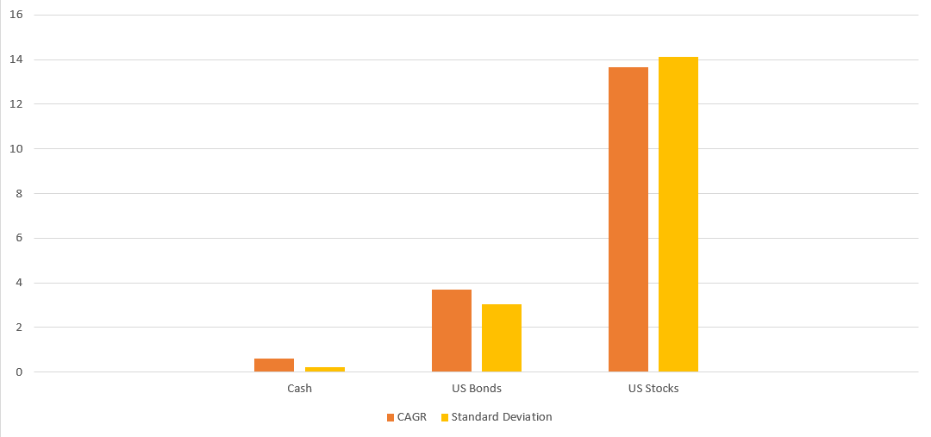
Risk and Return are Correlated
Standard Deviation (10 years )
T-Bills Bonds Stocks

Slide 34
The Third Dimension … Correlation
Total return, R
Standard deviation, S
Correlation, C
Measures how well two assets track each other
C = 1 for perfect tracking, i.e. zig and zag together
C = 0 for no correlation
C = -1 for perfect negative correlation
i.e. one asset zigs every time the other zags

Slide 35
Basic MPT Equations
For a portfolio, P, with 2 risky assets, A and B
with expected total returns RA and RB,
and standard deviations SA and SB
and correlation CAB
and weights WA and WB in the portfolio
RP = WA x RA + WB x RB
SP = SqRt{(WA x SA)^2 + (WB x SB)^2
+ 2 x WA x SA x WB x SB x CAB}

Slide 36
Simple Portfolio with 2 Risky Assets
First asset (e.g. a bond fund)
Return = 5%
Standard deviation = 4%
Second asset (e.g. a stock fund)
Return = 10%
Standard deviation = 15%
Weights: Vary from 0, 10%, 20% … 100%
Correlation: Vary from +1.0, +0.5, 0, -0.5, -1.0

Slide 37
2 Assets: Correlation = 1.0
100%
Stocks
100%
Bonds
Standard Deviation

Slide 38
2 Assets: Correlation = 0.5
100%
Stocks
100%
Bonds
Standard Deviation

Slide 39
2 Assets: Correlation = 0
100%
Stocks
100%
Bonds
Standard Deviation

Slide 40
2 Assets: Correlation = -0.5
100% Stocks
100%
Bonds
Standard Deviation

Slide 41
2 Assets: Correlation = -1.0
100%
Stocks
100%
Bonds
Standard Deviation

Slide 42
How Well Does MPT Work in Practice?
Let’s look at simple portfolios comprising the total US bond and stock funds we examined earlier
Portfolio 1
90% Total US bond fund
10% Total US stock fund
Portfolio 2
30% Total US bond fund
70% Total US stock fund

Slide 43
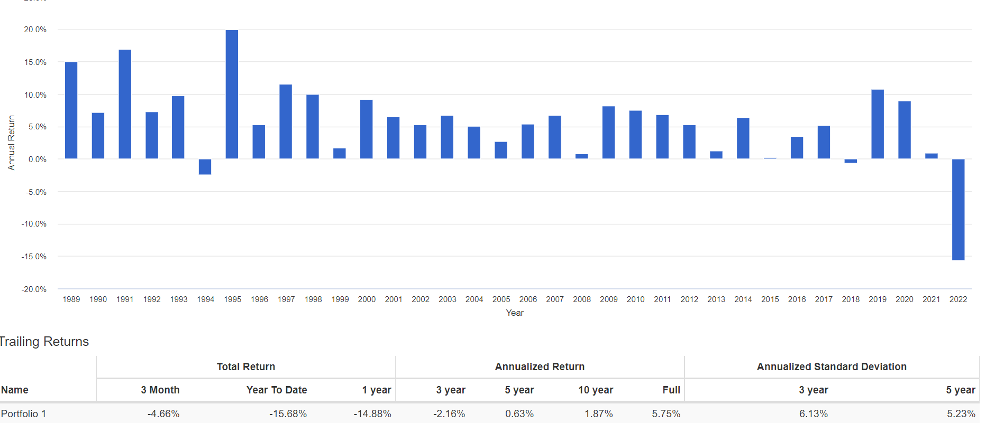
Simple 2-Asset Portfolio 1 90% Bond Market + 10% Stock Market
25%

Slide 44
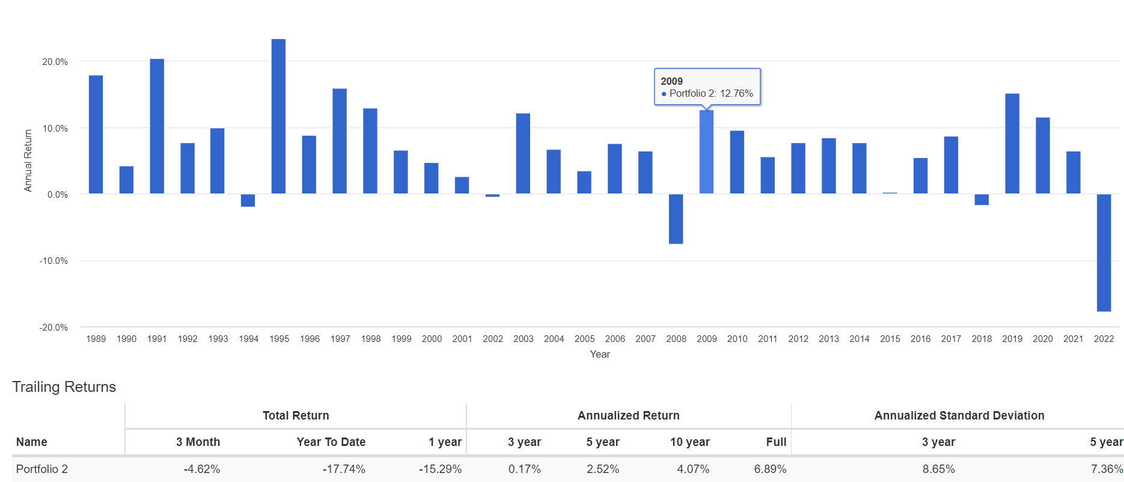
Simple 2-Asset Portfolio 2 30% Bond Market + 70% Stock Market
30%

Slide 45
Characteristic data for Simple 2-Asset Portfolios (1989 – 9/2022)
 | Bond Fund | Portfolio 1 | Portfolio 2 | Stock Fund
Weight Bnd/St | 100%/0 | 90%/10% | 30%/70% | 0/100%
33yr CAGR | 5.14% | 5.75% | 6.89% | 9.92%
Std Deviation | 3.92 | 4.02 | 5.56 | 15.11
Sharpe Ratio | 0.62 | 0.75 | 0.75 | 0.52
US Mkt Corr. | 0.13 | 0.49 | 0.87 | 1.00
Best Year | 18.18% | 19.94% | 23.46% | 35.79%
Worst year | -14.65% | -15.68% | -17.74% | -37.04%
# Down years | 5 | 3 | 5 | 7

Slide 46
How Can We Diversify Further?
Replace Total US bond fund
with short-term and intermediate term bonds
Replace Total US stock fund
with large/small cap, value/growth index funds
Add real estate index, commodity index funds
Add international index funds
Developed markets, emerging markets

Slide 47
The Callan Periodic Table of Investment Returns

Slide 48
Correlations of Major Asset Classes Portfolio Visualizer 9/1/09 – 8/31/19

Slide 49
The Vanguard “Lazy Portfolios”
 | Total Bond Market | Total Stock Market | Intl. Stock Market | REIT
Rick Ferri | 40% | 60% | - | -
Rick Ferri | 40% | 40% | 20% | -
Rick Ferri | 40% | 40% | 24% | 6%
Bill Schulteis | 40% | 10+10+10+10% | 10% | 10%
William Bernstein | 40% | 15+10+5+10 | 5+5+5% | 5%
Frank Armstrong | 30% | 7+9+6+9% | 31% | 8%
David Swenson | 15+15% | 30% | 15+10% | 15%

Slide 50
To Keep It Really Simple! One-Fund Solutions
Vanguard Life Strategy Funds
Fixed Income Equities
U.S. Intl. U.S. Intl.
VASIX Income Fund 56% 24% 12% 8%
VSCGX Conservative Growth Fund 42% 18% 24% 16%
VSMGX Moderate Growth Fund 28% 12% 36% 24%
VASGX Growth Fund 14% 6% 48% 32%
Target Date Funds: 2020, 2025, 2030 … 2055
Vanguard, Fidelity, T Rowe Price, etc.

Slide 51
Rick Ferri’s 6 Rules for Disciplined Investing
Have a long-term investment philosophy.
Form a prudent asset allocation based on this philosophy.
Select low-cost funds to represent asset classes in the allocation.
Maintain this portfolio through all market conditions.
Don’t change the asset allocation due to recent market activity.
Don’t hold back on new investments while waiting for market clarity.

Slide 52
To Probe Further
Making Sense of Investment Risk, Paul Merriman, AAII Journal, March 2020
Rebalancing: A Sound Strategy for Limiting Risk, Vanguard, June 2019
Global Equity Investing, The Benefits of Diversification and Sizing Your Allocation, Vanguard, February 2019
The Importance of Diversification in Retirement Portfolios, Craig Israelsen, AAII Journal, April 2015
Portfolio Selection, Harry Markowitz, Journal of Finance, 1952
A Random Walk Down Wall Street, Burton Malkiel, Norton & Co.
Winning the Loser’s Game, Charles Ellis, McGraw-Hill
Investing at Level 3, James Cloonan, AAII

Slide 53
Useful Websites
http://aaii.com Broad selection of investing material
http://siliconvalleyaaii.org Previous presentations on various topics
https://sccld.org/resources/business/ Business & Money
Morningstar Research Center, S&P’s NetAdvantage, Value Line
https://portfoliovisualizer.com Free access to a wide selection of tools
https://vanguard.com https://fidelity.com https://schwab.com
http://scallan.com Callan chart
http://bogleheads.org Interesting blog
https://obliviousinvestor.com/index-funds/ Mike Piper blog
https://rickferri.com/investment-philosophy/ Rick Ferri blog
https:/muscularportfolios.com Brian Livingston

